Slide 1
DATA PROCESSING
Data processing refers to the manipulation and transformation of raw data into meaningful information through various techniques and methods. The goal of data processing is to extract useful insights, support decision-making, and facilitate the interpretation of data.
data collection
data cleaning
data transformation
data storage
data analysis
data visualization
data interpretation

Slide 2
DATABASE
METADATA
A SELF-DESCRIBING COLLECTION OF INTEGRATED RECORDS.
refers to data that provides information about other data. It offers context and details about a particular piece of data, making it easier to understand, manage, and use. Metadata can describe various aspects of data, including its origin, format, structure, and content.
THE PURPOSE OF A DATABASE IS TO KEEP TRACK OF THINGS.
It is a structured collection of data that is designed to store, manage, and efficiently retrieve information. They are used in various industries and fields, including business, healthcare, finance, education, government, and more.
Collection of tables + relationships among rows in those tables + special data "metadata" = database

Slide 3
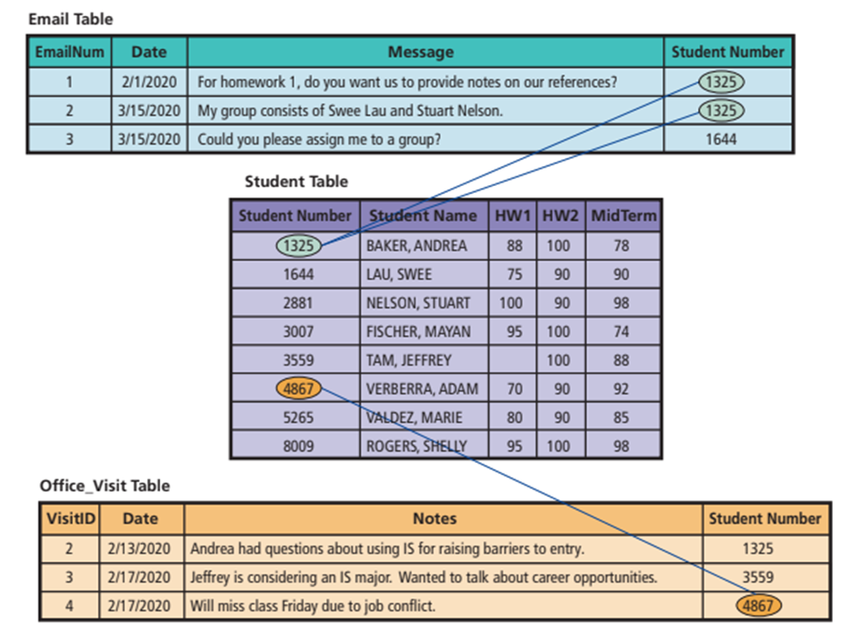
RELATIONSHIP AMONG DATABASE

Slide 4
UNDERSTAND THE TECHNIQUES FOR PROCESSING DATABASES.
CREATING THE DATABASE AND ITS STRUCTURES
Database developers use the DBMS to create tables, relationships, and other structures in the database.
Metadata forms are used to define new tables or modify existing ones.
Developers can add or remove columns using metadata forms.

Slide 5
UNDERSTAND THE TECHNIQUES FOR PROCESSING DATABASES.
2. PROCESSING THE DATABASE
The second function of the DBMS is to process the database.
The DBMS provides applications for four processing operations: to read, insert, modify, or delete data.

Slide 6
UNDERSTAND THE TECHNIQUES FOR PROCESSING DATABASES.
3. STRUCTURED QUERY LANGUAGE
It is an international standard language for processing a database.
It can also be used to create databases and database structures.

Slide 7
UNDERSTAND THE TECHNIQUES FOR PROCESSING DATABASES.
4. ADMINISTERING THE DATABASE
A third DBMS function is to provide tools to assist in the administration of the database.
Database administration includes activities such as setting up security systems, user accounts, passwords, permissions, and limits.

Slide 8
UNDERSTAND THE TECHNIQUES FOR PROCESSING DATABASES.
5. DATABASE SECURITY
To provide database security, users must sign in with valid accounts for database access, and permissions can be specified in detail.
DBMS allows the establishment of a security system with user accounts, passwords, and permissions.
Permissions can be finely tuned, restricting users to specific operations on certain parts of the database (e.g., read-only access to specific columns)

Slide 9
UNDERSTAND THE TECHNIQUES FOR PROCESSING DATABASES.
6. DBMS ADMINISTRATIVE FUNCTIONS
It include backing up database data, adding structures to improve the performance of database applications, removing data that are no longer wanted or needed, and similar tasks.

Slide 10
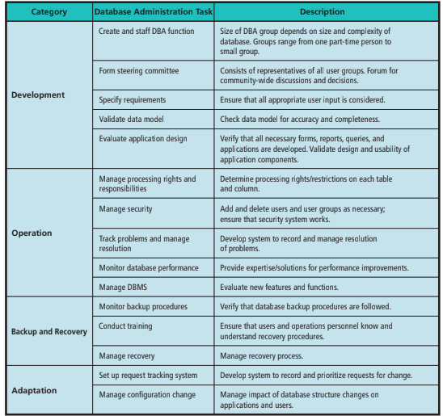
SUMMARY OF DATABASE ADMINISTRATION (DBA) TASKS

Slide 11
HOW IS A DATA MODEL
TRANSFORMED INTO A
Database Design?
Database design is the process of converting a data model into tables, relationships, and data constraints.
The database design team transforms entities into tables and expresses relationships by defining foreign keys.

Slide 12
RELATIONSHIP AMONG ROWS
A key (also called a Primary Key or PK) is a column or group of columns that identifies a "unique row" in a table.
Every table must have a key.
Foreign keys (FK) - This term is used because such columns are keys, but they are keys of a different (foreign) table than the one in which they reside.

Slide 13
RELATIONAL DATABASES
Databases that carry their data in the form of tables and that represent relationships using foreign keys are called relational databases.
DATABASE MANAGEMENT SYSTEM (DBMS)
Is a program used to CREATE, PROCESS, AND ADMINISTER a DATABASE.
Companies license DBMS products from vendors such as:
• IBM - DB2
• Microsoft - Access and SQL Server
• Oracle - Oracle Database
• MySQL

Slide 14
DBMS vs DATABASES
Database Management System - software program.
Database - collection of tables, relationships, and metadata.

Slide 15
HOW DO DATABASE APPLICATIONS MAKE DATABASE USEFUL?
A database application is a collection of forms, reports, queries, and application programs that serves as an intermediary between users and database data. Database applications reformat database table data to make it more informative and more easily updated.

Slide 16
HOW DO DATABASE APPLICATIONS MAKE DATABASE USEFUL?
The specific purposes of the four elements of a database application are:
Forms - View data; insert new, update existing, and delete existing data
Reports - Structured presentation of data using sorting, grouping, filtering, and other operations.

Slide 17
HOW DO DATABASE APPLICATIONS MAKE DATABASE USEFUL?
Queries - Search based on data values provided by the user
Application programs - Provide security, data consistency, and special purpose processing.
Database applications emerged in the 1990s, with systems like ERP and SAP as enduring extensions. While some systems persist, today's versions use web technologies, like browsers, making them more dynamic and suitable for today's needs.

Slide 18
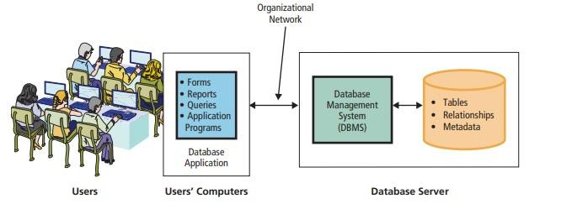
TRADITIONAL DATABASE
Traditional DB apps are written in object-oriented languages such as C++ and VisualBasic (and even in earlier languages like COBOL) are thick and needs to be installed on users' computers. Even today, traditional apps, especially in ERP and CRM, still exist, but we might move towards browser-based applications in the future.

Slide 19
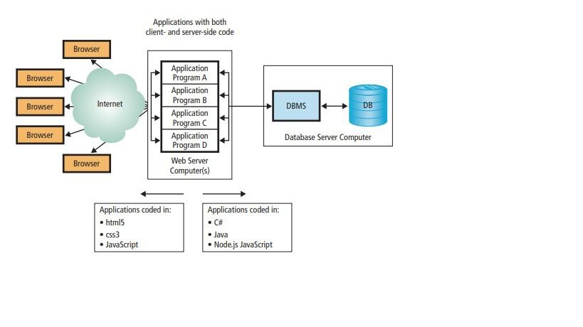
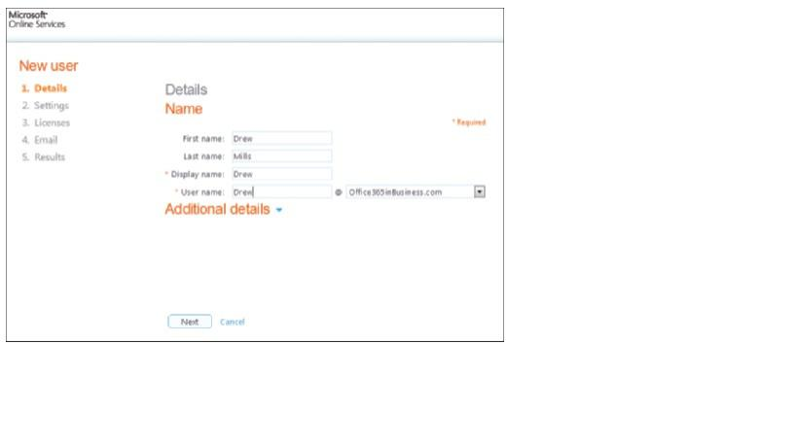
BROWSER FORMS, REPORTS, QUERIES
BROWSER-BASED APPLICATION

Slide 20
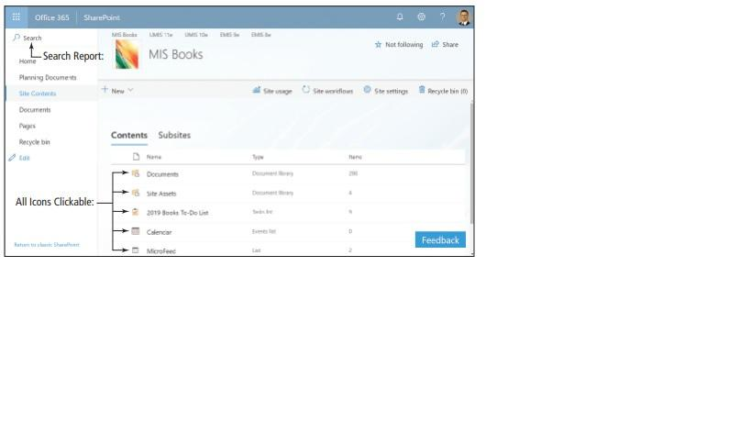
MULTI-USER PROCESSING

Slide 21
ER DATA MODEL
DATA MODEL
The roles of entity relationship data model for database development.
It is a tool for constructing data models that defines the entities stored in a database and the relationships among those entities.
Roles of ER Data model: conceptualization and communication
It is a logical representation of database data which describes the data and relationships that will be stored in the database.
DATA MODEL
Conceptualization and abstraction
DATABASE DESIGN
Implementation and optimization

Slide 22
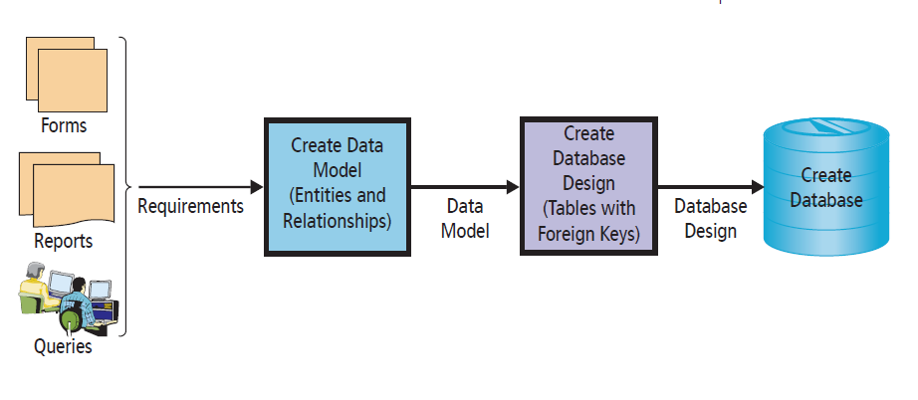
DATABASE DEVELOPMENT MODEL
NORMALIZATION
It is the process of converting poorly structured tables into two or more better-structured tables.
It aims to enhance data integrity.

Slide 23
SUMMARY
The goal of data processing is to extract useful insights, support decision-making, and facilitate the interpretation of data.
Database is a structured collection of data that is designed to store, manage, and efficiently retrieve information.
The purpose of a database is to efficiently and systematically organize, store, manage, and retrieve data. Databases serve as centralized repositories for data, providing a structured and organized way to store information.
The purpose of data processing is to transform raw data into meaningful information through a series of systematic steps and operations.

